Slide 1
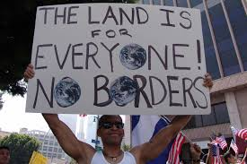
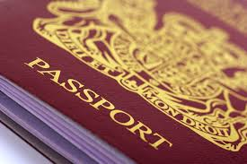
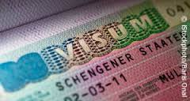
BORDERS AND VISAS
DO WE NEED THOSE???
Why do we need them?
When do we need them?

Slide 2
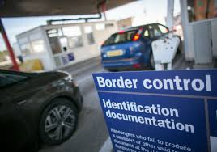
In modern times, the concept of a marchland has been replaced by that of the clearly defined and demarcated border. For the purposes of border control, airports and seaports are classed as borders
Most countries have some form of border control to regulate or limit the movement of people, animals, plants, and goods into or out of the country.

Slide 3
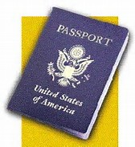


Some borders require presentation of legal paperwork like:

Slide 4
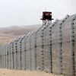
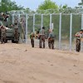
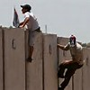
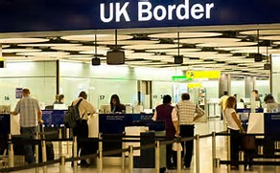
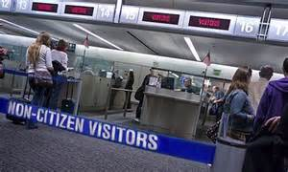
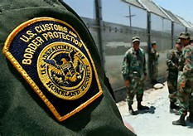
In regions where smuggling, migration, and infiltration area problem, many countries fortify borders
with fences and barriers
and institute formal border control procedures

Slide 5
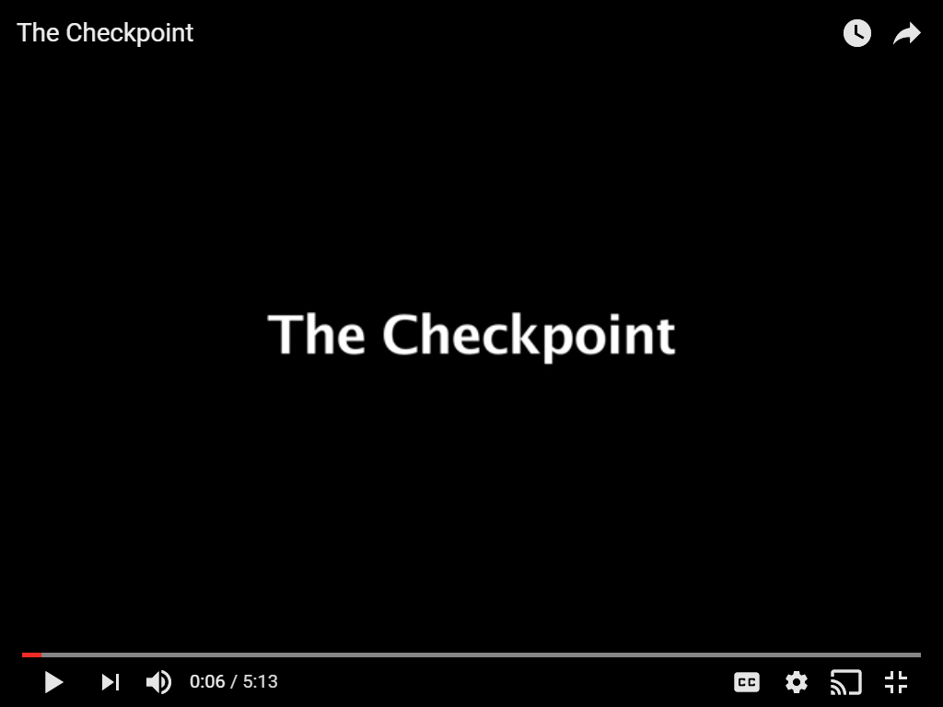
https://www.youtube.com/watch?v=Fl8ToeCWfS4
A Short film by Porter Speakman, Jr. (@porterspeakman)
"The Checkpoint" looks at the system of Israeli checkpoints in the West Banks and the daily routine Palestinians must face going through the Bethlehem Checkpoint.

Slide 6
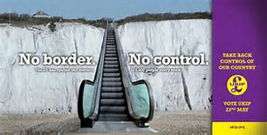
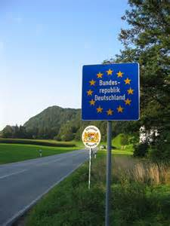
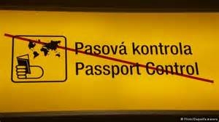
Borders may even be completely unmarked, typically in remote or forested regions

Slide 7
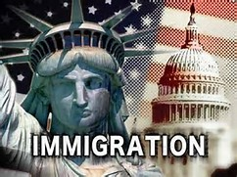
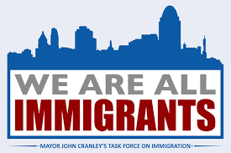
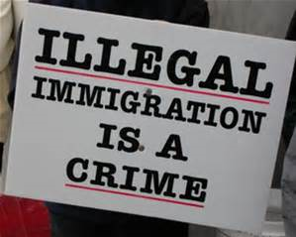
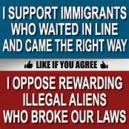
Why do people cross borders?
Migration
Illegal immigration

Slide 8
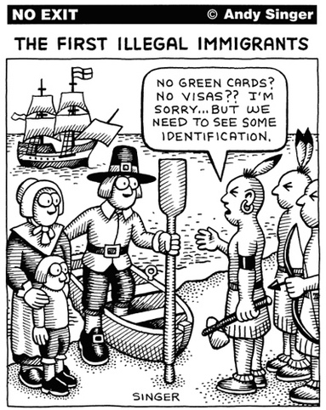
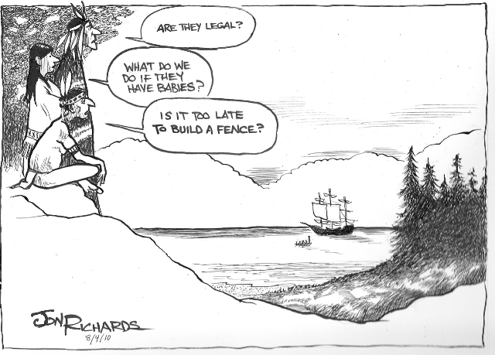
BIG IDEAS
The United States is a nation of immigrants from a variety of different backgrounds. These immigrants come from nations across the world, have differing reasons for living in the United States, and have unique stories about their journey.

Slide 9
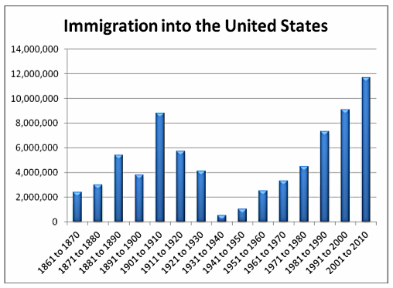
2014 - 1,016,518 people are granted lawful permanent residence in the United States

Slide 10
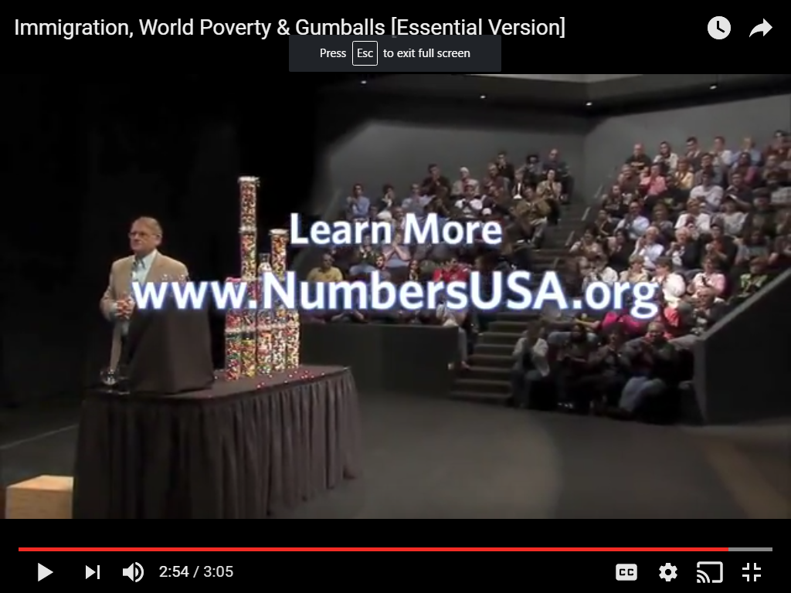
https://www.youtube.com/watch?v=ubGzbj59_Xs
Why immigration will never help reducing world poverty as it is basically pointless. Moreover, it is even damaging those countries.

Slide 11
Immigration - is it a threat or not?
examine and compare borders around the world and their related issues
Research on rights people have when they enter another country
Do you approve of immigration?
What makes people cross borders illegally?
As an example use immigration issues relates to the country you are from

