Slide 1
Your Holiday
For Arina from 6th grade

Slide 2
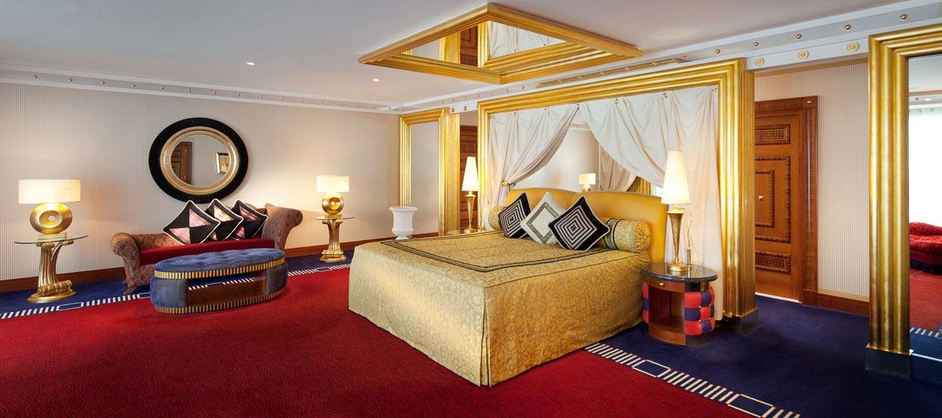
Where?
So you wanted the Burj al Arab so you’ll get it. As you said the budget is unlimited
I have found the room in the Jumeirah hotel. It is a two bed-room luxury suite.
Three people would comfortably fit
in this lush room, fit for kings.

Slide 3
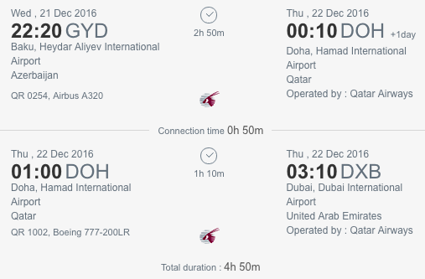
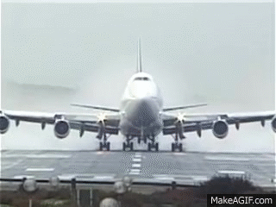
How to get there?
Qatar Airways has flights from Baku to Dubai on the 21st, the day the holidays start. You would be booked into business class. But you’d have to fly through Doha. Making a stop there. You would leave Baku at twenty past and arrive in
Dubai by 10 past three, Dubai time.

Slide 4
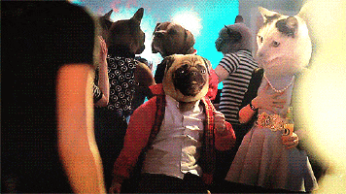
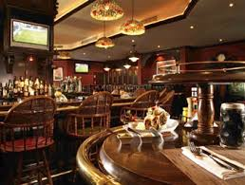
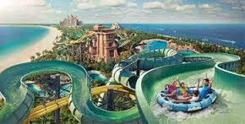
What Activity?
You said you wanted something Christmas themed. In the Boston Bar on the 24th there is going to be a Christmas Eve party, perfect for the family.
This bar is absolutely wonderful and it’s perfect for people wanting the true Christmas Experience.
Also you can always go to Atlantis, the greatest aquapark in the world, and it’ll be warm enough to go there.
25-28 degrees celsius.

Slide 5
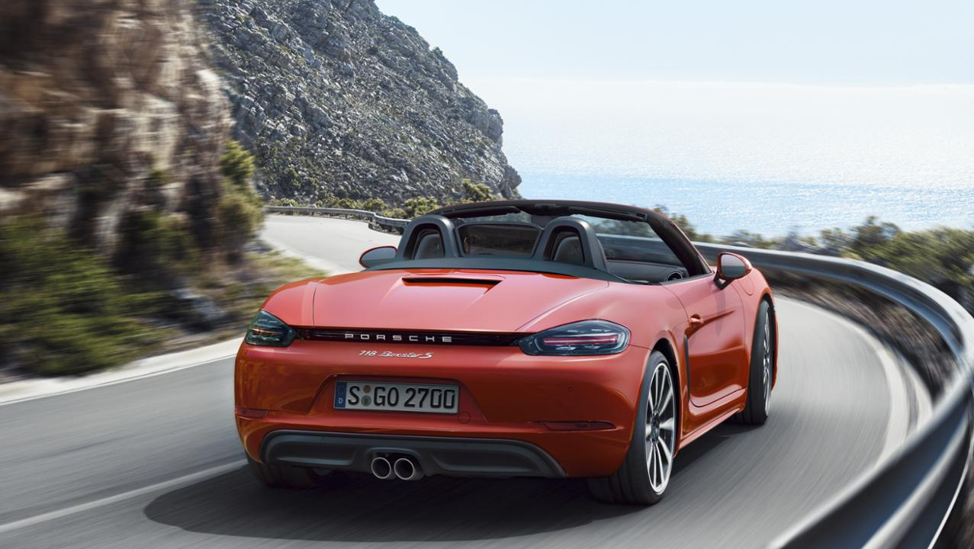
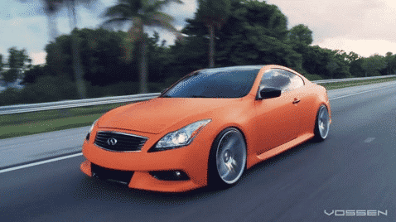
What Vehicle?
There’s a Porsche dealer that is selling a Porsche 718 Boxster Convertible. It’s perfect for three people and a convertible in Dubai is absolutely perfect.

Slide 6

How Much?
The Hotel room=14382 AED=6836.54 AZN
Flight=8,055.57 AZN
Car= 119500 AZN
Dinner at the Boston=300 AZN
Atlantis=730 AZN
Total=135422.11 AZN

Slide 7

THANKS FOR WATCHING

